Slide 1
CMC
Patch Planning RFE

Slide 2
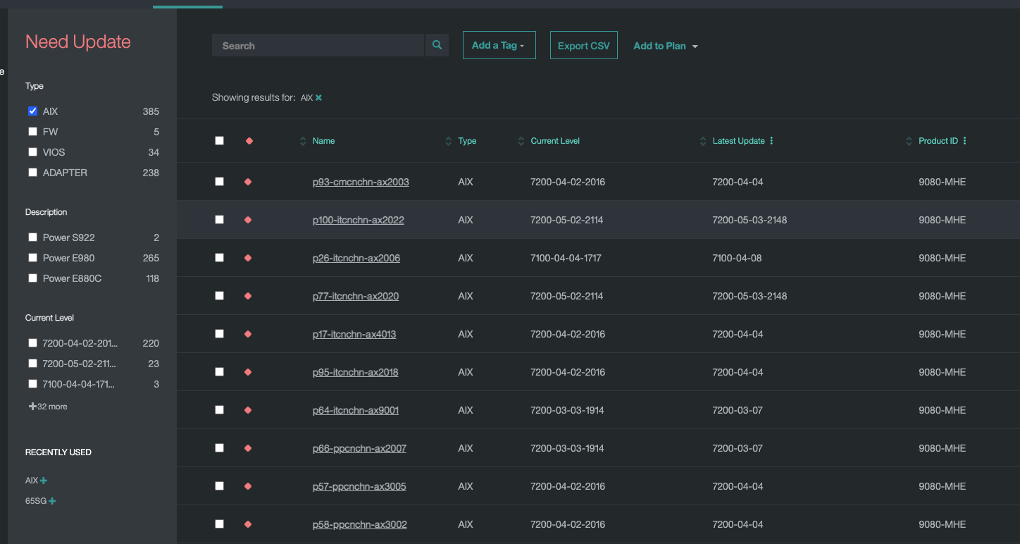
Maybe different colours or selection/choice to see EoS, EoSPS, EoL, also latest as in today.
It would make things more relevant, I mean chasing the latest is not always what one wants, more to know that one is on an ok and supported level.
Also I think that 1 SP could be “ok”, but I see some 4 SP downlevel which is really bad and Red is red..

