Slide 1
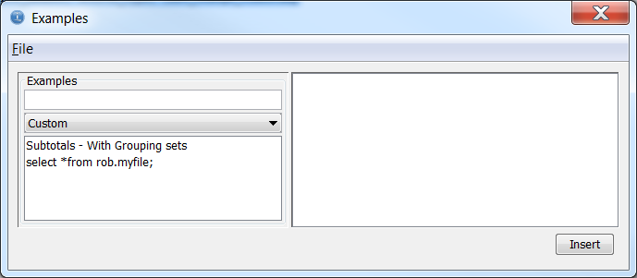
Use first example, Subtotals

Slide 2
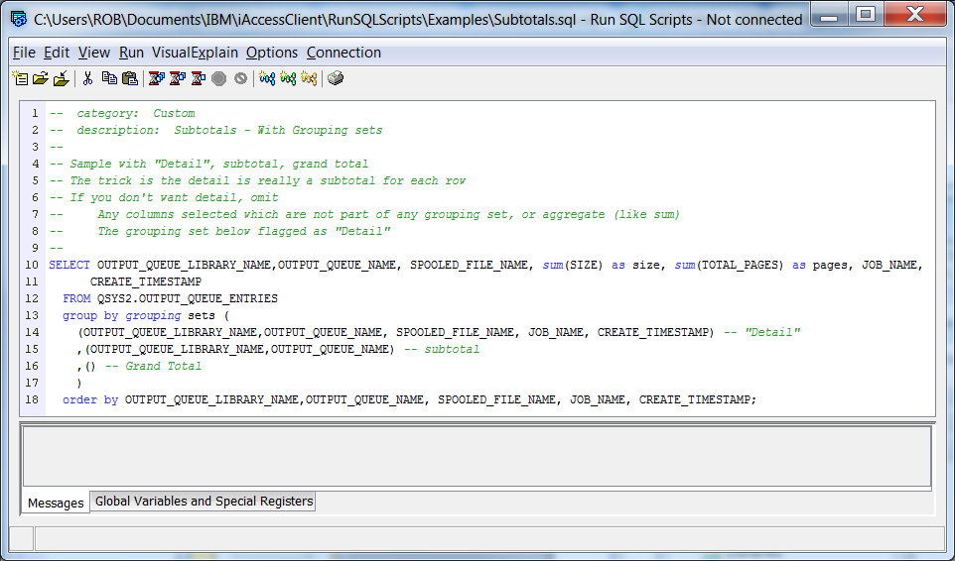
What I have in the file

Slide 3
What appears when I insert it

