Slide 1
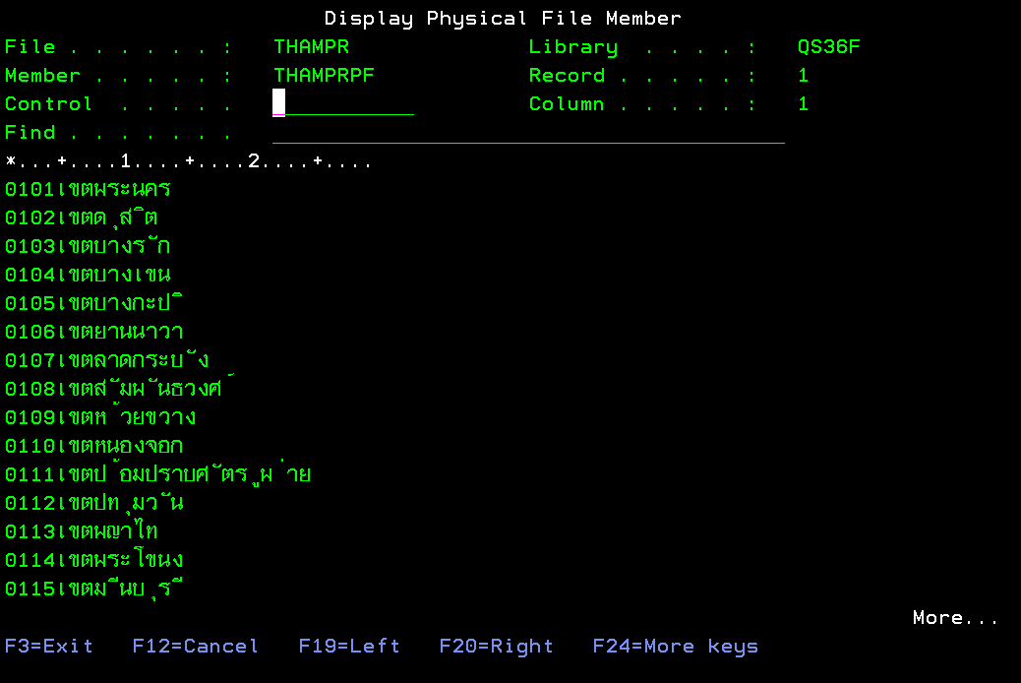
This is the iseries display screen with Thai language.

Slide 2
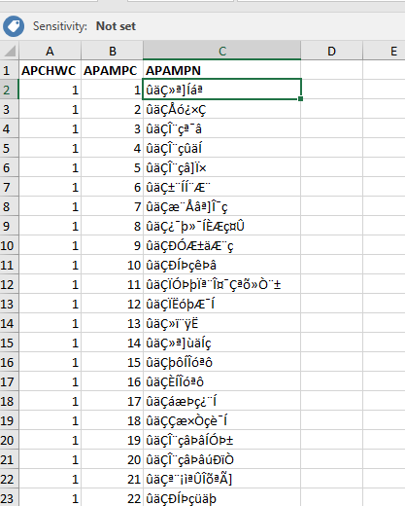
This is the file download from iSeries by use IBM I Access program.
You will see TH language in column C are fault.

Slide 3
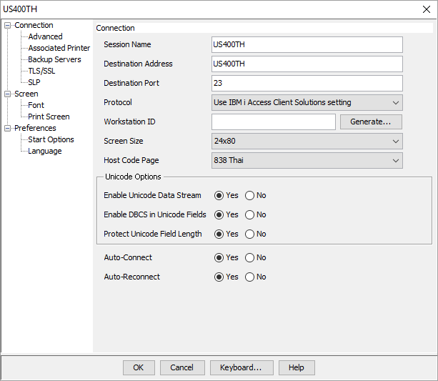
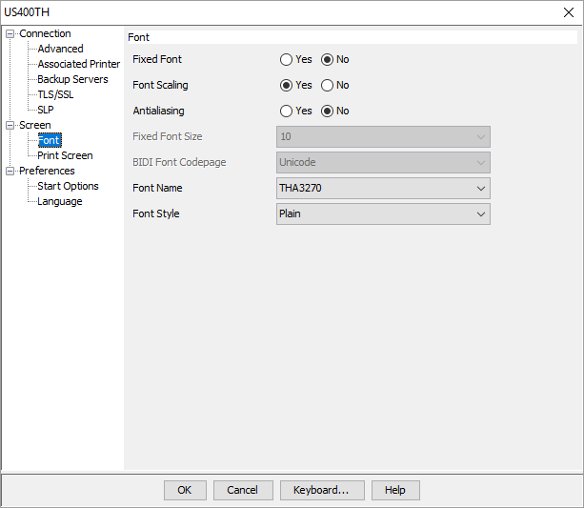
This is the setup parameter of my IBM I Access.

Slide 4
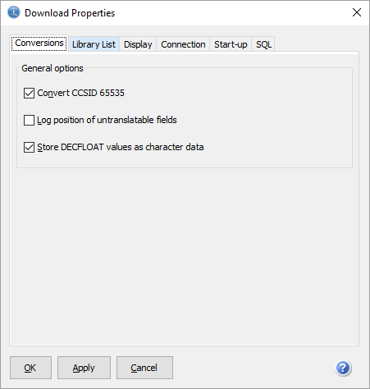
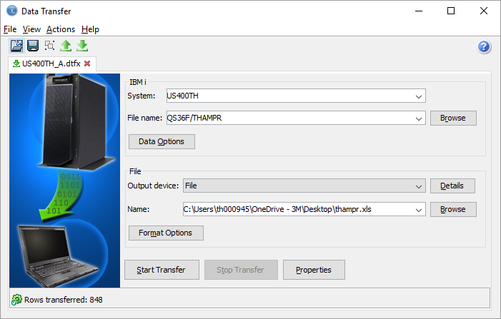
This is the setup parameter of my IBM I Access.

